Slide 1
Linux Plus for AWS and DevOps
Notes:
Good Evening Everybody!
How are you doing today! By the way I am Marcus! This is my first time that I have InClass session with you!
Let me introduce myself first, then we can start our today’s session.
I live in Germany and working as a DevOps Engineer in an Industrial IoT company in Berlin. Mostly I’ll be with you on Linux sessions and couple of other AWS sessions.
Today we are going to start our Linux Lessons!
Let’s get started, this is essentially advance Linux but not such a difficult course, we’ ll cover many topics but you don’t memorise them.
Today we’re gonna cover Basics concept of Linux and File Management,
In our upcoming lessons, respectively we’ll handle Environment variables, and how to manage users & groups on Linux.
We’ll get into Package Managers,
after Package managers we’ll cover Filters and control Operators.
And in our last three sessions we’ll learn Bash scripting.

Slide 2
Table of Contents
What We Learn
Getting Help
Text Editors
File Management
Notes:
Here are the topics we will cover today.
We’ll talk about the Linux overview and how to get help from Linux terminal about our commands
We’ll talk about Text Editors and finally file management.

Slide 3
What We Learn
1

Slide 4
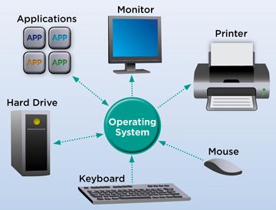




What is Linux?
Free
Open-Source
OS
Notes:
Let’s talk about what is Linux!
Basicly we can say Linux is an OS.
What’s differentiate Linux from other OS like Windows and MacOs.
The answer is Linux is a Free and Open-Source Operating System.
It means it is free to use, you don’t have to pay for it but also its code is available to anyone. There are a lot of different flavors and distros, since its code base is open to world.
As we know, an operating system (OS) is a system software that manages computer hardware, software resources, and provides common services for computer programs.
Another popular element in Linux is its mascot, a penguin figure named Tux.

Slide 5
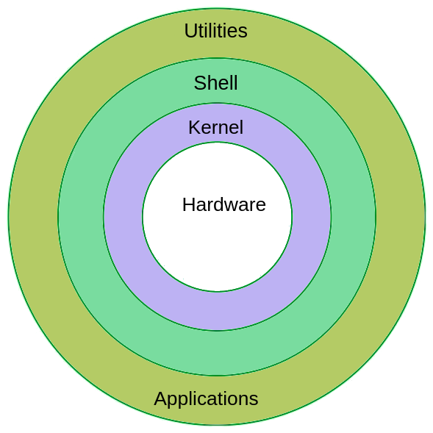
Components of Linux
USER
USER
Notes:
Kernel: It is the core part of the Linux system. It interacts with the hardware. It manages various components like the CPU, peripheral devices, and memory.
Shell: The Shell is an interface between the user and the Kernel. It takes user commands through the Terminal and processes the particular request.
Commands and Utilities: The Linux operating system comes with a Terminal that users can use to pass commands to the Shell. One simple command is the ‘ls’ which shows the contents of a folder
For understanding the components, First you need to understand what a computer operating system or OS is. As I’ve stated earlier, an OS is the computer code which manages the hardware in a physical computer. It exists as a layer between your software and your hardware. Most people writing software do not want to know how to address a CPU in assembler, or how to communicate with a graphics card. An OS such as Linux or Windows acts as a middleman.
Every OS has component parts, and the Linux also has the following components:
OS Kernel. You can call the kernel the part of the operating system which is the “closest” to your computing hardware as it is the part which controls the CPU, access to memory and any peripheral devices. It is the “lowest” level at which your operating system works.
OS Shell. You need to be able to tell our operating system what to do, and this is the goal of the shell. Also known as the command line, it is a facility which lets you instruct your OS using text. However few people nowadays are familiar with command line code, and it once used to put people off using Linux. This changed because a modern distribution of Linux will use a desktop shell just like Windows.
It’s worth noting that Ubuntu’s application repository, the Ubuntu software centre, is a great place to look around for Linux applications, both free to use and paid to use.
https://www.quora.com/What-is-difference-between-Ubuntu-and-Linux

Slide 6
What is Linux Distributions
UBUNTU
FEDORA
CENTOS
DEBIAN
SOFTWARE
SOFTWARE
SOFTWARE
SOFTWARE
LINUX KERNEL
Notes:
A Linux distribution (often abbreviated as distro) is an operating system made from a software collection that is based upon the Linux kernel.
Linux users usually obtain their operating system by downloading one of the Linux distributions, which are available for a wide variety of systems ranging from embedded devices (for example, OpenWrt) and personal computers (for example, Linux Mint) to powerful supercomputers (for example, Rocks Cluster Distribution).
A typical Linux distribution comprises a Linux kernel, GNU tools and libraries, additional software, documentation, a window system (the most common being the X Window System), a window manager, and a desktop environment.
Most of the included software is free and open-source software made available both as compiled binaries and in source code form, allowing modifications to the original software. Usually, Linux distributions optionally include some proprietary software that may not be available in source code form.
A Linux distribution may also be described as a particular assortment of application and utility software (various GNU tools and libraries, for example), packaged together with the Linux kernel in such a way that its capabilities meet the needs of many users.^{[2]}
The software is usually adapted to the distribution and then packaged into software packages by the distribution's maintainers. The software packages are available online in so-called repositories, which are storage locations usually distributed around the world.^{[3][4]} Beside glue components, such as the distribution installers (for example, Debian-Installer and Anaconda) or the package management systems, there are only very few packages that are originally written from the ground up by the maintainers of a Linux distribution.
https://en.wikipedia.org/wiki/Linux_distribution

Slide 7

Popular Linux Distributions
Debian
Ubuntu
Mint
Manjaro
openSUSE
RedHat
Fedora
Notes:
And Those are the popular Linux Distros.

Slide 8
Using Linux on Different Platforms
Notes:
The question is that, which environment should we use for the lessons. There are a few of the alternatives in the following slides, but we will not install any of them during our lessons. We‘ll use Amazon EC2 Instances during our sessions.

Slide 9
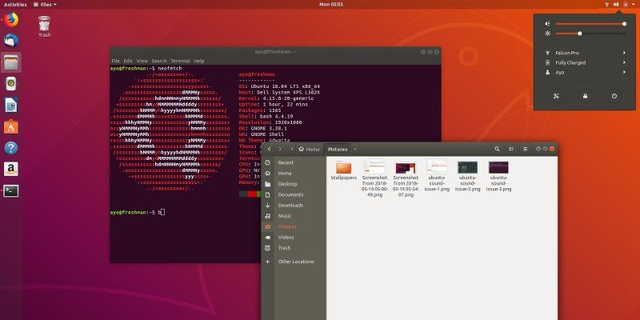
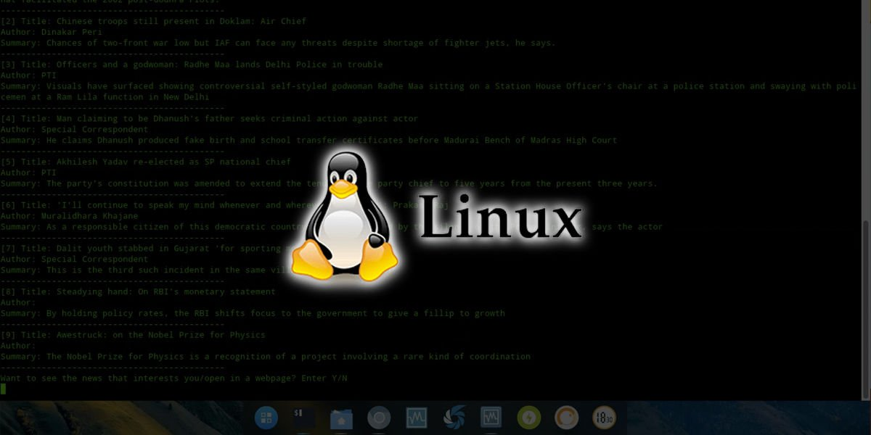
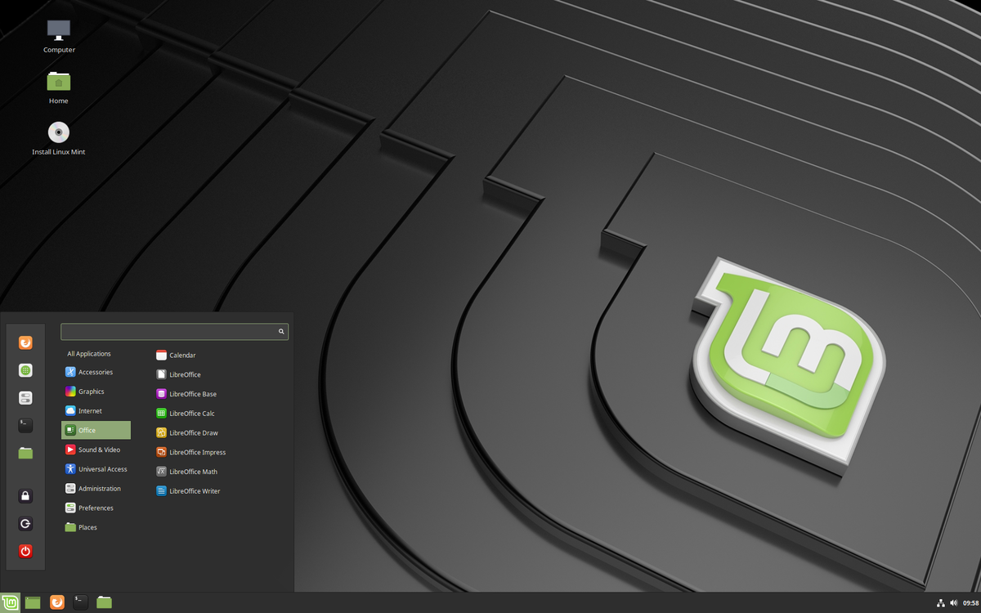
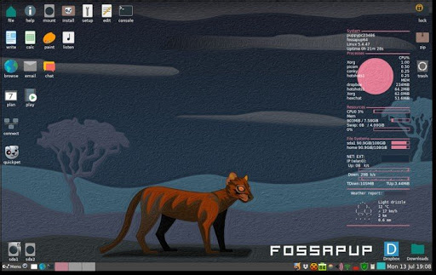
Linux Alternatives
Notes:
The best way for learning Linux is using Linux. And the best environment for using Linux is to have a Linux machine running directly on a Linux distro. However, this is not possible for the most cases. And we are going to see the alternatives in the following slides.

Slide 10
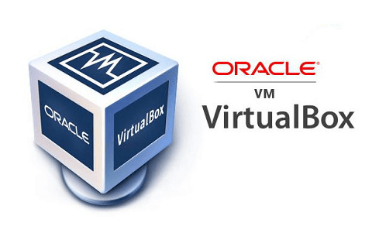
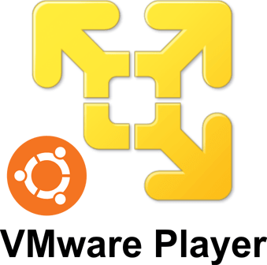
Linux Alternatives
Linux Distros on Virtual Machines
MacOS/Windows
Windows
https://www.virtualbox.org/wiki/Downloads
https://www.vmware.com/products/workstation-player/workstation-player-evaluation.html
Notes:
First option is to use virtual machines on your MacOS or Windows platforms.
For this configuration, first you must install Oracle VirtualBox for Windows or MacOS or VMware for Windows.
You can just search and find the web sites and download the appropriate software for your operating system.

Slide 11


Linux Alternatives
Linux Distros on Virtual Machines
https://ubuntu.com/download/desktop
https://www.debian.org/distrib/netinst
Notes:
After setting up the appropriate Virtual Machine on your local computer, you can download and install one of the Linux distros you like. You can use the links on the screen for ubuntu and debian. You can also find other alternatives on internet as well.
https://ubuntu.com/download/desktop
https://www.debian.org/distrib/netinst

Slide 12

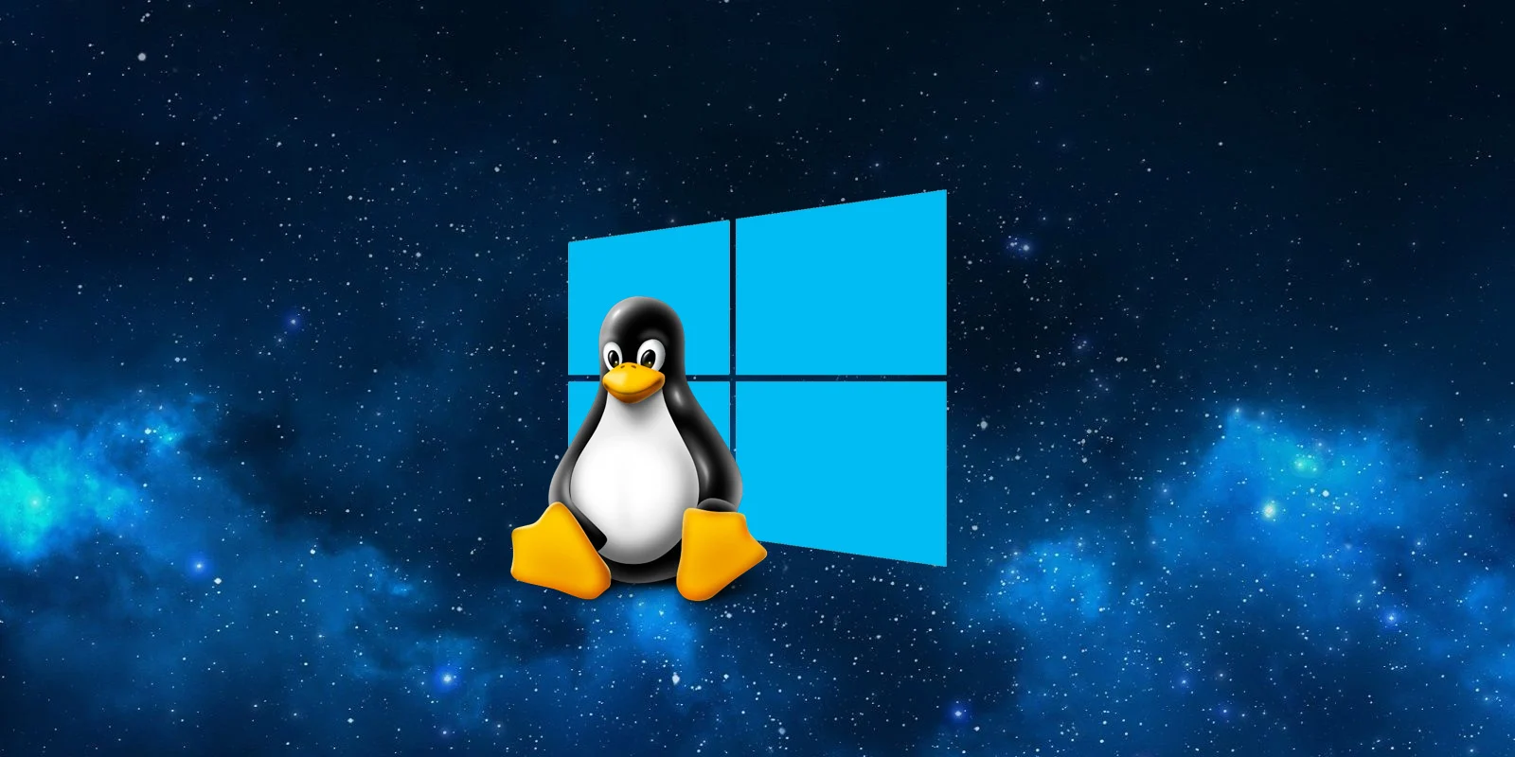
Linux Alternatives
WSL
Notes:
Another common way for using Linux on Windows is “WSL” which stands for “Windows Subsystem for Linux”.
This alternative has almost all the capabilities of a Linux distro.
At least it is more than enough for our purposes in this course.

Slide 13
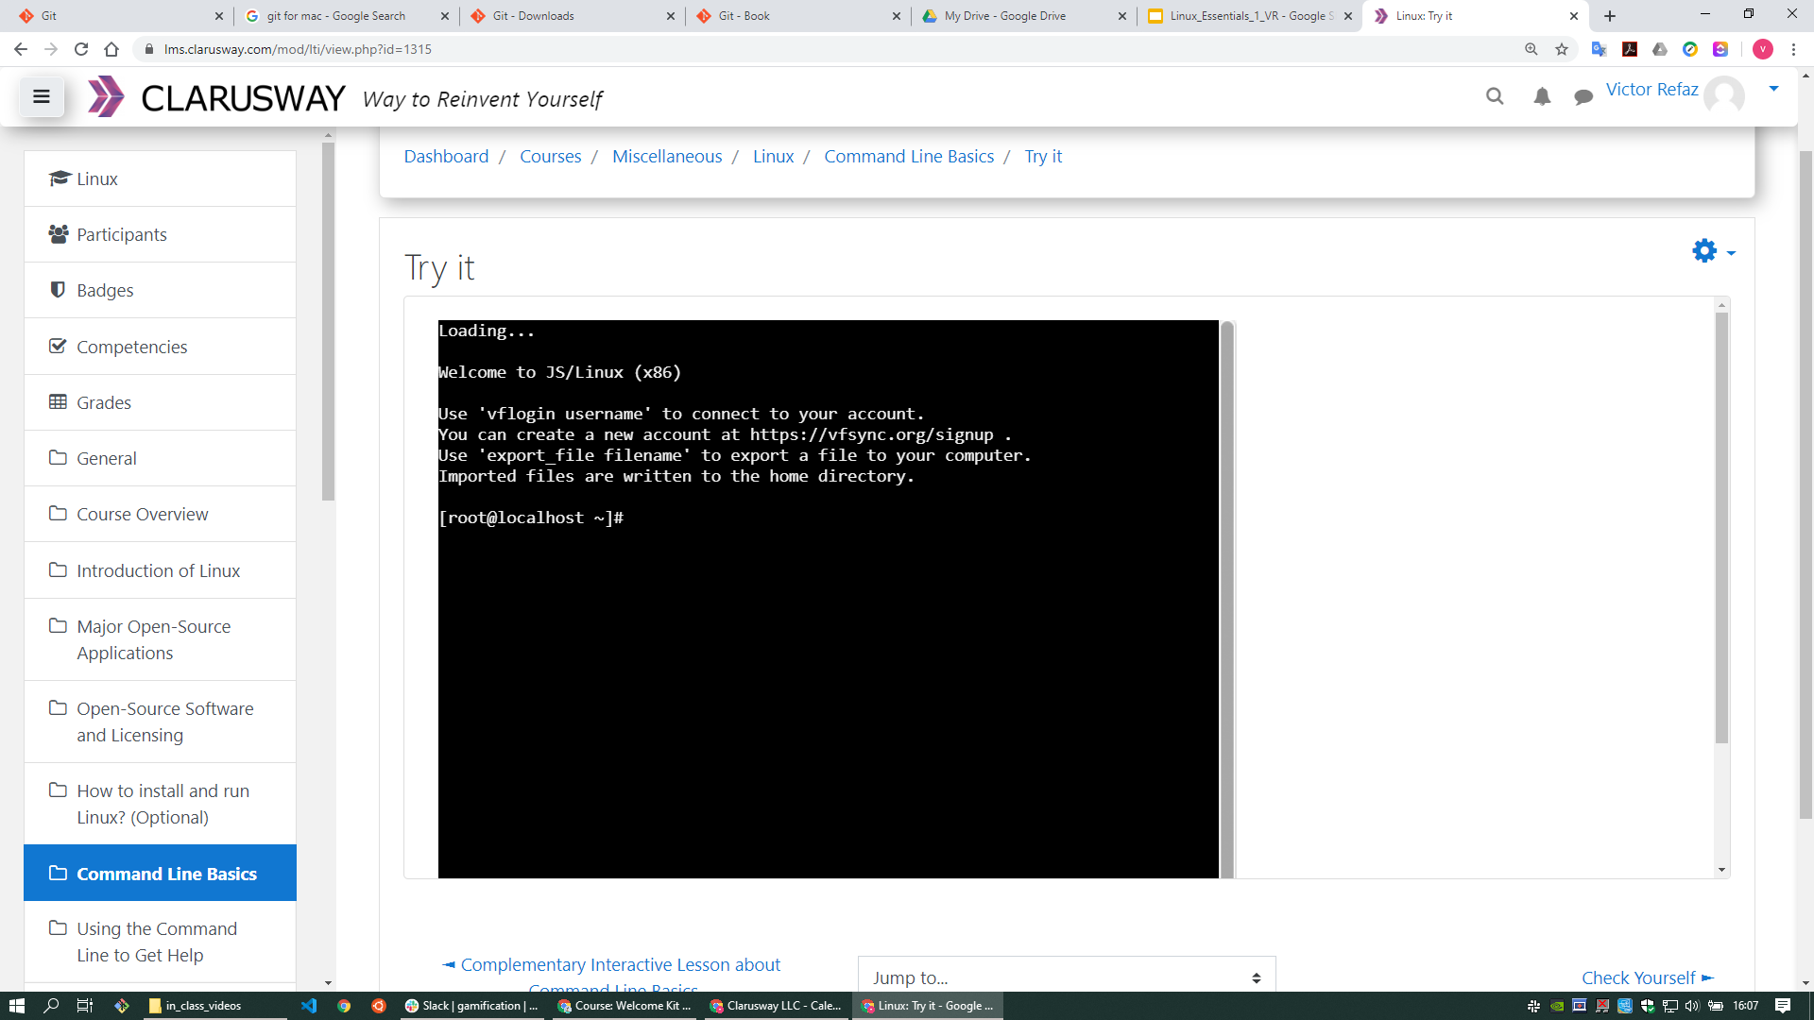
Linux Alternatives
LMS: Try it
Notes:
Another alternative is using LMS. In LMS you can use “Try It” option. Although it’s a limited version, it is sufficient for our learning purposes.

Slide 14
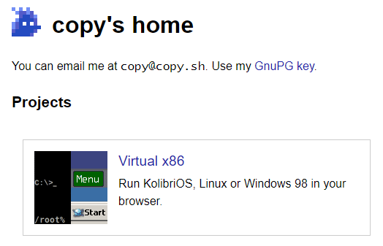
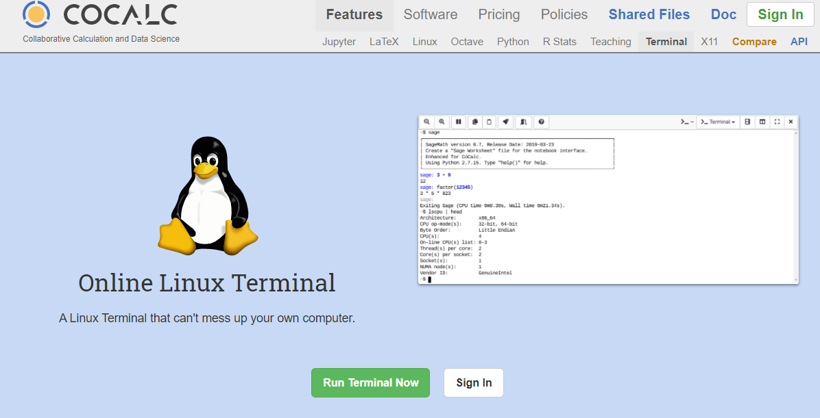
Linux Alternatives
https://copy.sh/
https://cocalc.com/doc/terminal.html
Notes:
Also, you can use internet based alternatives. Here are just two examples. If you like you can find many other sites that you can use as a Linux emulator.

Slide 15
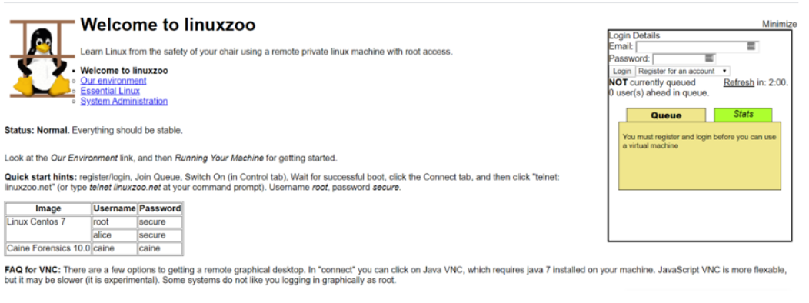
Linux Alternatives
linuxzoo.net
Notes:
Another internet based alternative is, “linuxzoo.net”.
You need to register first, then you can login to a remote Linux machine and practice your abilities. However, it is limited in time and number of users and sometimes it’s not easy to find an empty slot.

Slide 16
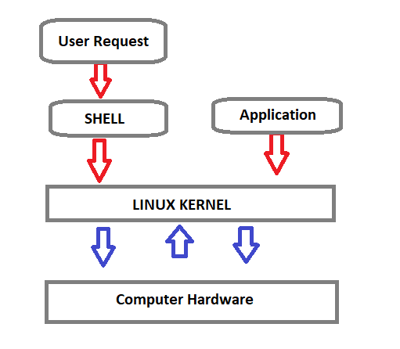
What is SHELL?
Shell is a program that receives the user's commands and gives them to the operating system to process and displays the output.
Bash (Bourne Again SHell) is an enhanced version of Steve Bourne's first Unix shell application, and serves as the shell program on most Linux systems.
Notes:
Shell is a program that receives the user's commands and gives them to the operating system for processing and displaying the output. We use the Shell through the CLI (command-line interface).
The shell is basically a program that takes keyboard commands and gives them to the operating system to conduct. A program called bash serves as the shell program on most Linux systems (which stands for Bourne Again SHell, an enhanced version of Steve Bourne's first Unix shell application, sh).

Slide 17

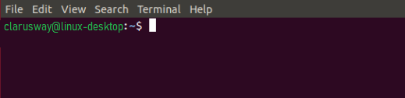
What is SHELL?
The standard Linux shell is both a command-line interpreter and a programming language.
The command prompt for Linux generally shows the current user, the current host, and the appropriate directory.
At the end of the prompt list, the $(dollar sign) signifies the current user being unprivileged, and the device is ready to receive feedback.
The input is sent for parsing and execution to the interpreter.
Notes:
The standard Linux shell is both a command-line interpreter and a programming language.
The command prompt at the beginning of the command line is a short text string. The command prompt for Linux generally shows the current user, the current host, and the appropriate directory.
The prompt of the command can be easily modified to display as desired more or less information. At the end of the prompt string, the $ (dollar sign) signifies that the current user is unprivileged, and the device is ready to receive feedback.
The input is sent for parsing and execution to the interpreter. The most common interpreter is BASH or the Bourne Again Shell, but there are others available, some of them are using different signs instead of the dollar sign.

Slide 18
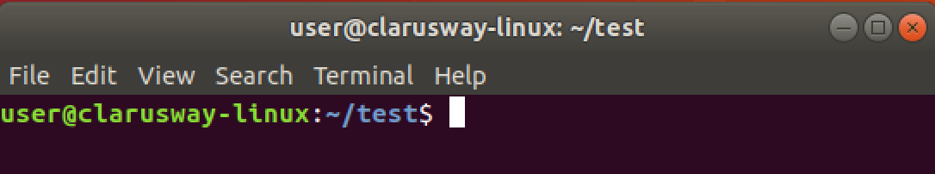
Command Prompt
User Name
Host Name
Current Directory
User Type
$ normal user
# Privileged user
Notes:
When we look deeply at the command prompt we see some details about our environment. For example, here, user refers to the current logged on user. And host name is generally the machine being used. Then, the current directory, where the user is working on and lastly user type, which is a $ sign means the current user is a normal user without extra privilages.

Slide 19
Basic Shell Commands
COMMAND | DESCRIPTION
pwd | show current path
ls | lists directory contents
cd | change (current) directory
mkdir | create a new directory
rmdir | delete an empty directory
touch | create a file
rm | delete a file
Notes:
Though you can see the current path on your command prompt, the most used command, in my opinion, is pwd.
It is my habit to look and confirm my working directory by using this command. Especially if you are the root user, it becomes more important to know where you are on the system.
Let’s do it together please...

Slide 20
Basic Shell Commands
COMMAND | DESCRIPTION
cp | copy a file to another location
mv | move a file to another location
cat | show file contents
echo | print message to screen
clear | clear the terminal screen
Notes:
Though you can see the current path on your command prompt, the most used command, in my opinion, is pwd.
It is my habit to look and confirm my working directory by using this command. Especially if you are the root user, it becomes more important to know where you are on the system.
Let’s do it together please...

Slide 21


Slide 22
Getting Help
2
Notes:
Proverb
give a man a fish and you feed him for a day; teach a man to fish and you feed him for a lifetime
In this section we’ll learn how to get help from Linux terminal. There a couple of option to do it. I am using mostly google and if you stuck somewhere or get error then just google it. There are many generous and helpful people to provide solution to us. (Stackoverflow is most popular website which i use mostly.
Go to AWS Clarusway-team account and launch a linux instance

Slide 23
Table of Contents
Man Pages
Info Pages
whatis command
apropos command
--help option
Notes:
As a mention before there are couple of option for it
like Man pages, Info pages
whatis command
apropos command ( this one is not popular one)
and finally –help option

Slide 24
Man Pages
2-1
Notes:
Let’s start wit man pages
Man is short form of manual. You can find depth explanation of your command
Anytime you stuck how to use particular command, then you can use it.
Sometimes you dont remember all options of the command like -v -a -p -l
then you can easily reach those options.

Slide 25

Man Pages
A man page (short for manual page) is a form of software documentation usually found on a Unix or Unix-like operating system.
If we install a package to do some task, the man page for that package will typically be installed at the same time. This gives us the ability to take a look at that documentation and make sure that we're using it in a manner consistent with its design.
The man page for a particular command is invoked by man command.
man <command>

Slide 26
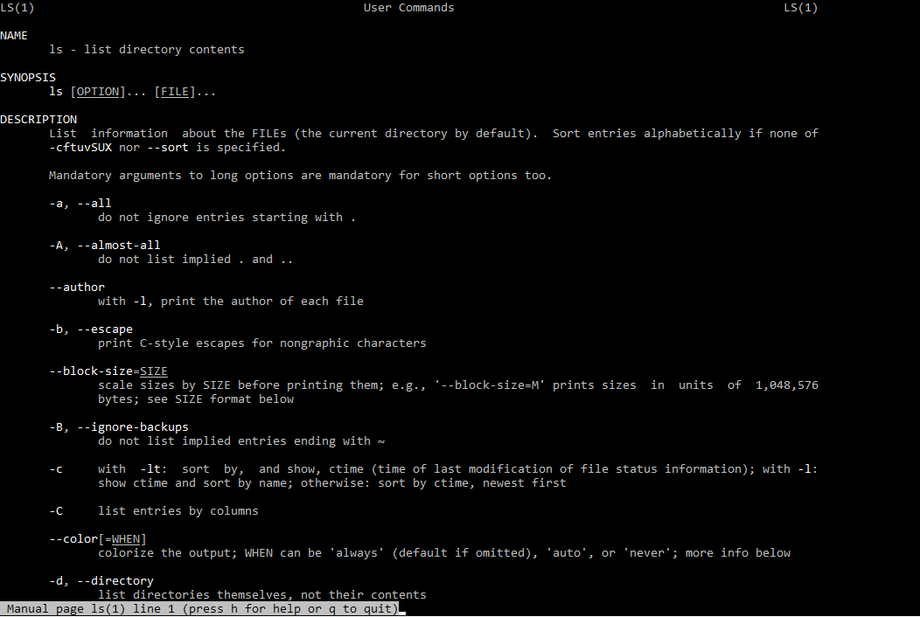
Man Pages
$ man ls
NAME
Program or Function name(s) followed by descriptions of functionality.
SYNOPSIS
A short overview of available options
DESCRIPTION
Detailed information about arguments and options.

Slide 27
Info Pages
2-2

Slide 28
Info Pages
Info pages are additional documentation with more robust capability in detail. Info pages normally provide more detailed information about a command than its respective man page.
info <command>
The info page for a particular command is invoked by info command.

Slide 29
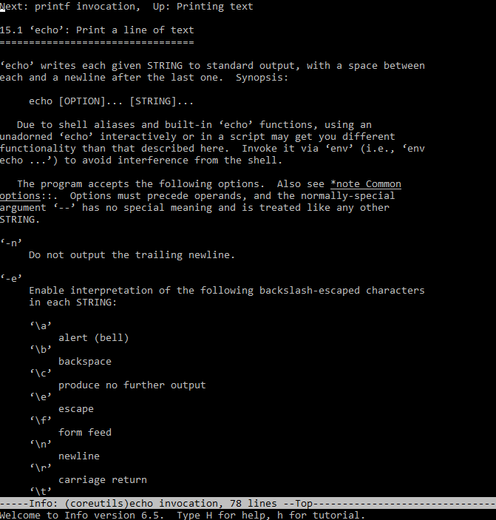
Info Pages
$ info echo
Notes:
In addition to the man pages, you can read the Info pages about a command, using the info command. These usually contain more recent information and are somewhat easier to use. The man pages for some commands refer to the Info pages.

Slide 30
whatis command
2-3

Slide 31
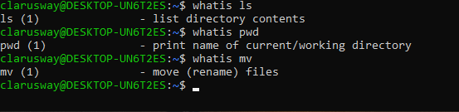
whatis command
display one-line manual page names.
whatis
Notes:
The whatis command is used to get brief information about Linux commands or functions. It displays the manual page description in a single line of the command that passes with the whatis command.

Slide 32
apropos command
2-4

Slide 33
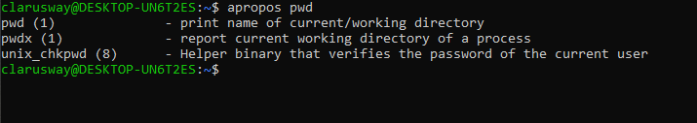
apropos command
search the manual page names and descriptions.
apropos
Notes:
We want to do something from Linux command line but we don't know where to get started. How can we search a command from linux terminal?
The apropos command searches the manual pages for a keyword or regular expression.

Slide 34
--help Option
2-5
Notes:
The help command is the simplest way to get information regarding a built-in shell command. It helps you fetch information from the shell's internal documentation. It takes a text string as the command line argument and looks for the provided string in the shell's documents.

Slide 35
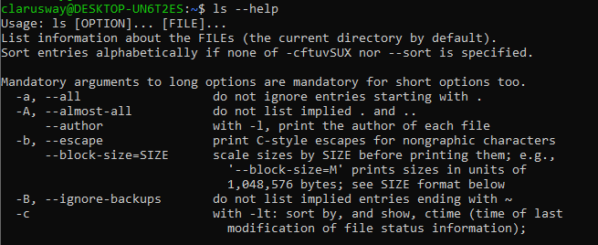
--help Option
gives a short explanation about how to use the command and a list of available options.
--help

Slide 36
Text Editors
3

Slide 37
Vİ/Vim Editor
3-1
Notes:
Why You Should Use Vi/Vim

Slide 38
Vi/Vim Editor
Vi is a text editor originally created for the Unix operating system.
Vim (Vi IMproved) as its name suggests, is a clone of Vi and offers more features than Vi.
The reasons why we should use Vi/Vim editor.
Vim is available on most linux distro’s.
Vim Uses Less Amount of System Resources.
Vim Supports All Programming Languages and File Formats
Vim is Very Popular in the Linux World

Slide 39
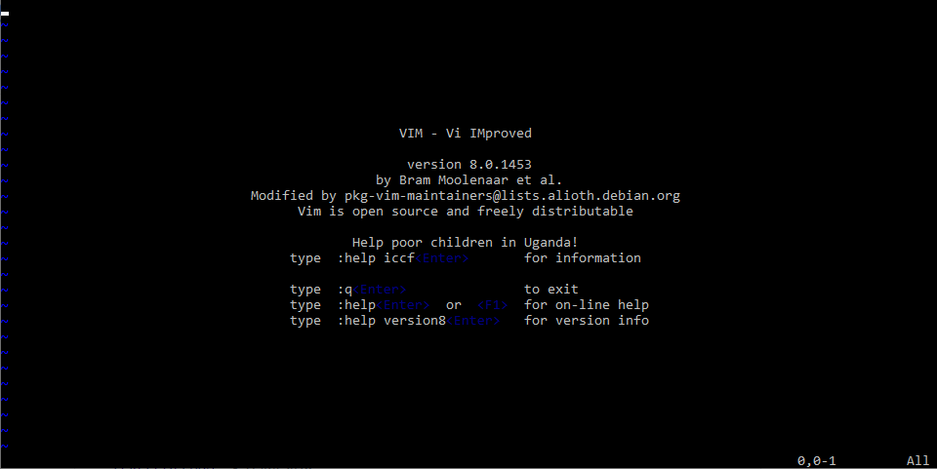
Vi/Vim Editor
Vim is a powerful text editor used in CLI (command line interface).
Vim is an editor to create or edit a text file.
When you start Vim, you are placed in Command mode. In this mode, you can move across the screen, delete text and copy text.
Command Mode
You cannot write text in command mode. To write text into a file, there is a dedicated insert mode. When you want to write something on a file, you must enter the insert mode.
Insert Mode

Slide 40
Vi/Vim Editor
Vim Command | Description
i | Enter insert mode
Esc | Enter command mode
x or Del | Delete a character
X | Delete character is backspace mode
u | Undo changes
Ctrl + r | Redo changes
yy | Copy a line
dd | Delete a line
p | Paste the content of the buffer
o | insert a blank line under the current cursor position.
:%s/foo/bar/g | Search and replace all occurrences
Esc + :w | Save changes
Esc + :wq or Esc + ZZ | Save and quit Vim
k
h
l
j

Slide 41
Nano Editor
3-2

Slide 42

Nano Editor
GNU nano is a small and friendly text editor.
Besides basic text editing, nano offers features like:
undo/redo
syntax coloring
interactive search-and-replace
auto-indentation
line numbers
word completion

Slide 43
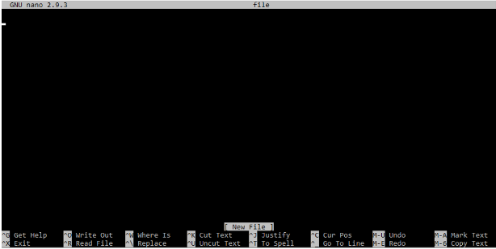
Nano Editor
Nano Command | Meaning
Ctrl G | Get Help
Ctrl X | Exit
Ctrl O | Write Out
Ctrl R | Read File
Ctrl W | Where Is
Ctrl \ | Replace
Ctrl K | Cut Text
Ctrl U | Uncut Text
Ctrl J | Justify
Ctrl T | To Spell
Ctrl C | Cur Pos
Alt U | Undo
Alt E | Redo
Unlike vi, nano is a modeless editor, which means that you can start typing and editing the text immediately after opening the file.
To open an existing file or to create a new file, type nano followed by the file name.
$ nano filename

Slide 44
Files
4-1

Slide 45
Files
On a Linux system, everything is a file.
A Linux system makes no difference between a file and a directory, since a directory is just a file containing names of other files.
The tree of the file system starts at the trunk or slash, indicated by a forward slash (/). This directory, containing all underlying directories and files, is also called the root directory or “the root” of the file system.

Slide 46
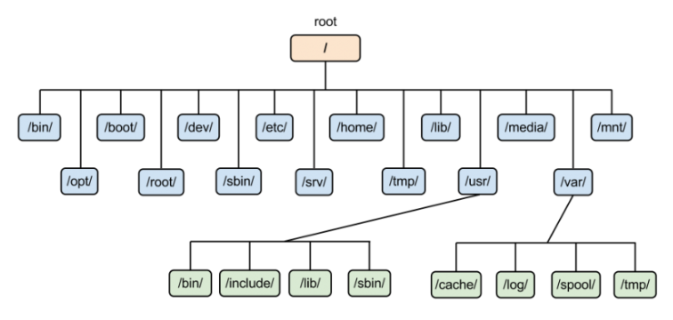
ROOT Directory ( / )

Slide 47
ROOT Directory ( / )
/bin Essential command binaries
/boot Static files of the boot loader
/dev Device files
/etc Host-specific system configuration
/home Users’ home directories
/lib Essential shared libraries and kernel modules
/media Mount point for removable media
/mnt Mount point for mounting a filesystem temporarily
/opt Add-on application software packages
/sbin Essential system binaries
/srv Data for services provided by this system
/tmp Temporary files
/usr Secondary hierarchy
/var Variable data
Notes:
/usr -----> unix system resources ----> keeps system wide read only files ----> keeps both /bin and /lib under /usr/bin and /usr/lib
/srv -----> you can put your web server’s static files

Slide 48
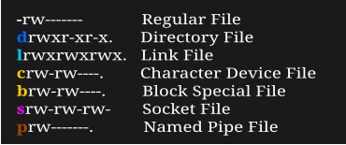
Files
Symbol | Meaning
- | Regular file
d | Directory
l | Link
c | Character Device File
s | Socket File
p | Named Pipe
b | Block Device
Notes:
c ------> Character and block device files allow users and programs to communicate with hardware peripheral devices
b ------> Similar to character devices. They mostly govern hardware as hard drives, memory, etc
s -------> Used for communication between processes. Generally, they are used by services such as X windows, syslog and etc.
p -------> Similar to sockets, allows communication between two local processes.
l ---------> pointer to an original file.

Slide 49
Viewing file properties
4-2

Slide 50
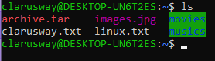
Viewing file properties
On most Linux versions ls is aliased to color-ls by default. This feature allows to see the file type without using any options to ls.
ls
Color | Meaning
Blue | directories
Red | compressed archives
White | text files
Pink | images
Cyan | links
Yellow | Devices
Green | Executables
flashing red | broken links
Notes:
ln -s file1 link1
gzip edit.txt
chmod +x file.sh

Slide 51
Working with File Contents
4-3

Slide 52
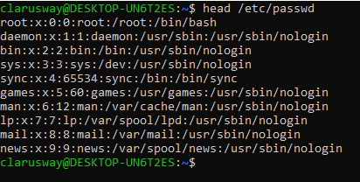
Working with File Contents
output the first ten lines of a file.
head

Slide 53
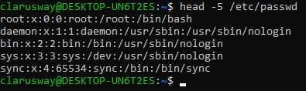
Working with File Contents
output the first n lines of a file.
head -n

Slide 54
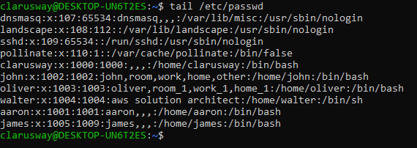
Working with File Contents
output the last ten lines of a file.
tail

Slide 55
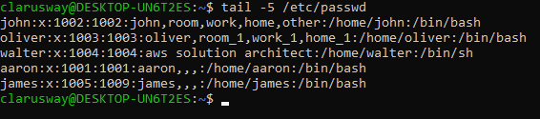
Working with File Contents
output the last n lines of a file.
tail -n

Slide 56
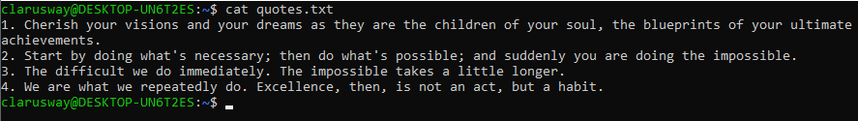
Working with File Contents
Display a file on the screen.
cat

Slide 57
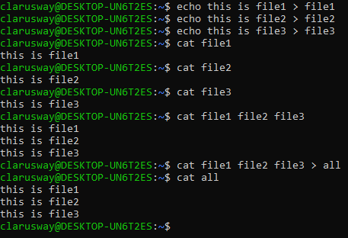
Working with File Contents
One of the basic uses of cat is to concatenate files into a bigger (or complete) file.
cat

Slide 58
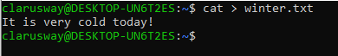
Working with File Contents
You can use cat to create flat text files.
cat
The Ctrl d key combination will send an EOF (End of File) to the running process ending the cat command.
Notes:
Flat file is a kind of file that is used like a database.
You put each record into a line.
You should use >> symbol to add an entry.

Slide 59
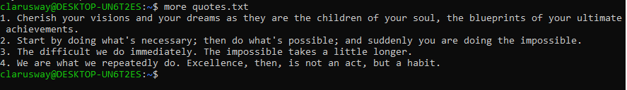
Working with File Contents
view (but not modify) the contents of a text file one screen at a time.
more

Slide 60
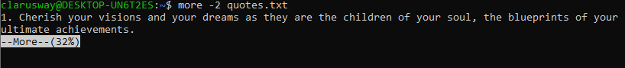
Working with File Contents
This option specifies an integer which is the screen size (in lines).
more -n
Notes:
Use up and down arrows to walk through the file.

Slide 61
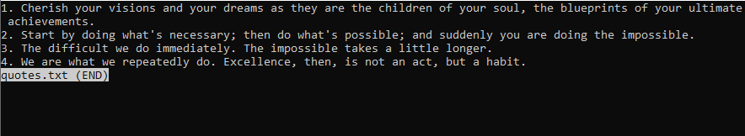
Working with File Contents
Similar to more, less command allows you to view the contents of a file and navigate through file. The main difference between more and less is that less command is faster because it does not load the entire file at once.
less
Notes:
Allows navigation though file using page up/down keys

Slide 62
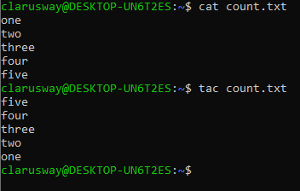
Working with File Contents
concatenate and print files in reverse.
tac

Slide 63
Searching Files
4-4

Slide 64
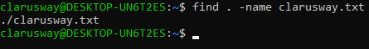
Searching Files
search for files in a directory hierarchy.
find
find [starting-point...] [expression]
Find all the files whose name is clarusway.txt in a current working directory.
find

Slide 65
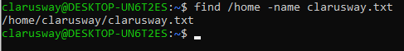
Searching Files
Find all the files whose name is clarusway.txt under /home directory.
find
Notes:
find . -mindepth 1 -maxdepth 3 -name "fol*"

Slide 66
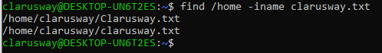
Searching Files
Find all the files whose name is clarusway.txt and contains both capital and small letters in /home directory.
find
Notes:
-i ---------> CASE INSENSITIVE

Slide 67
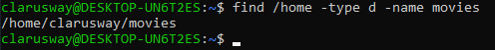
Searching Files
Find all directories whose name is movies in /home directory.
find

Slide 68
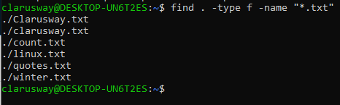
Searching Files
Find all txt files in a directory.
find

Slide 69
Searching Files
The grep, which stands for "global regular expression print," is used to search text.
grep
grep [options] pattern [files]
Options | Description
-c | This prints only the number of lines that match a pattern
-h | Do not display the filenames headers.
-i | Ignores, case for matching
-l | Displays list of a filenames only.
-n | Display the matched lines and their line numbers.
-v | This prints out all the lines that do not matches the pattern
Notes:
-h, --no-filename
Never print filename headers (i.e. filenames) with output lines. -----> this is useful if you’re searching multiple file in one command. (Ex.: grep -h “one” file.txt file2.txt file3.txt)
- l , ------> useful if you are searching among multiple files...

Slide 70
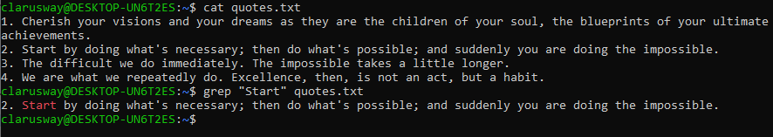
Searching Files
The grep searches the given file for lines containing a match to the given strings or words.
grep

Slide 71
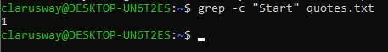
Searching Files
Returns the result of lines matching the search string.
grep -n
Returns the number of lines in which the results matched the search string.
grep -c

Slide 72
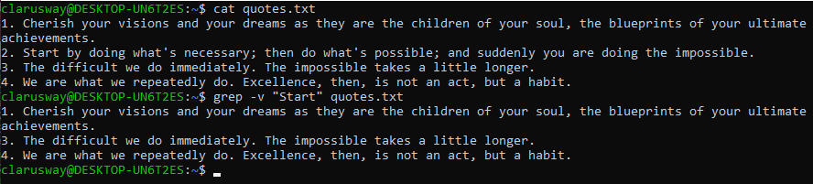
Searching Files
Returns the result of lines not matching the search string.
grep -v

Slide 73

THANKS!
Any questions?

